Slide 1
Average-Voice-Based Speech Synthesis Using HSMM-Based
Speaker Adaptation and Adaptive Training
Source: IEICE TRANS. INF. & SYST.
Author : Junichi Yamagishi, Takao Kobayashi
Professor : 陳嘉平
Reporter : 楊治鏞

Slide 2
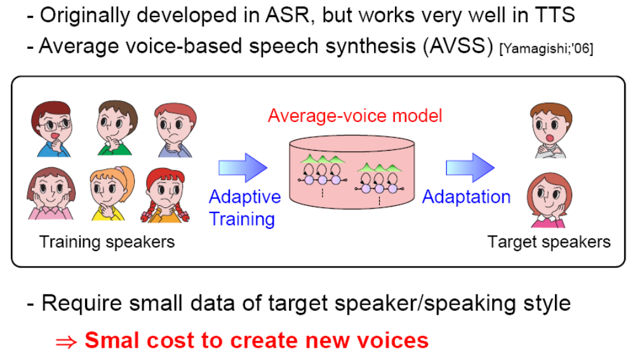
Speaker Adaptation

Slide 3
Introduction
In the previous work, the HMM-based speaker adaptation and speaker adaptive training were conducted for transforming and normalizing only state output probability distributions corresponding to spectrum and F0 parameters of the speech data.
The HSMM is an HMM with explicit state-duration probability distributions and enables us to conduct simultaneous adaptation of the output distributions and state duration distributions.

Slide 4
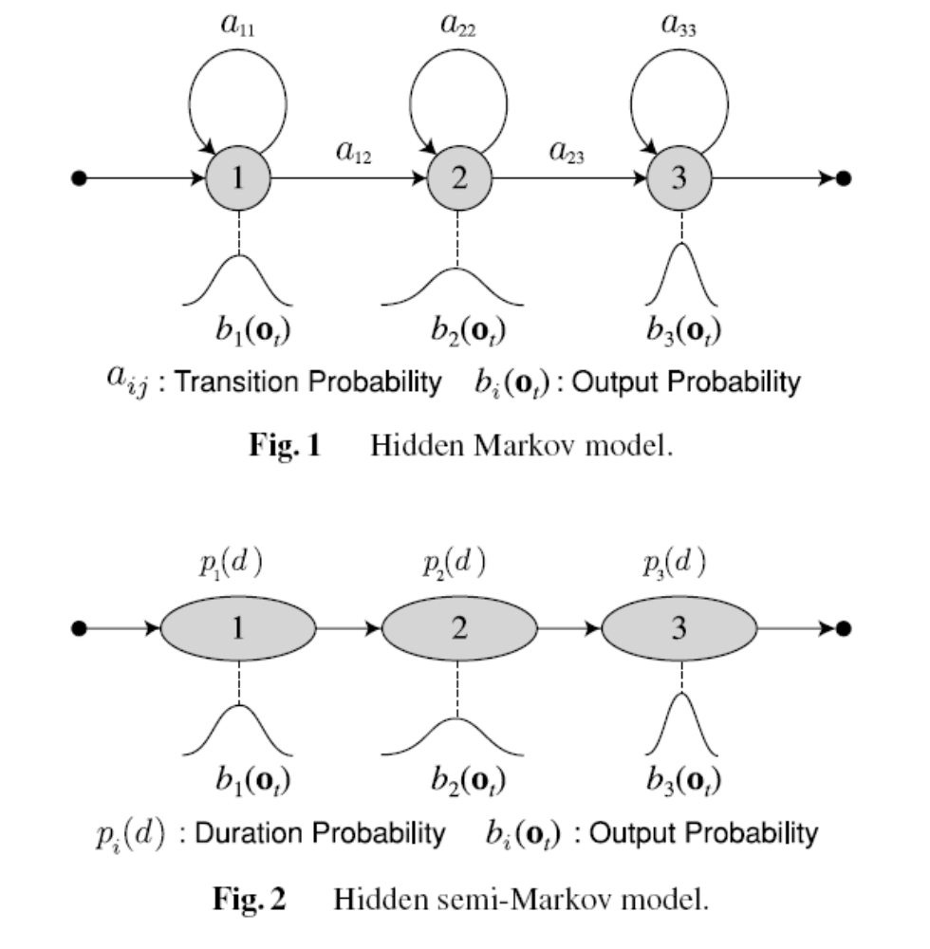

Slide 5
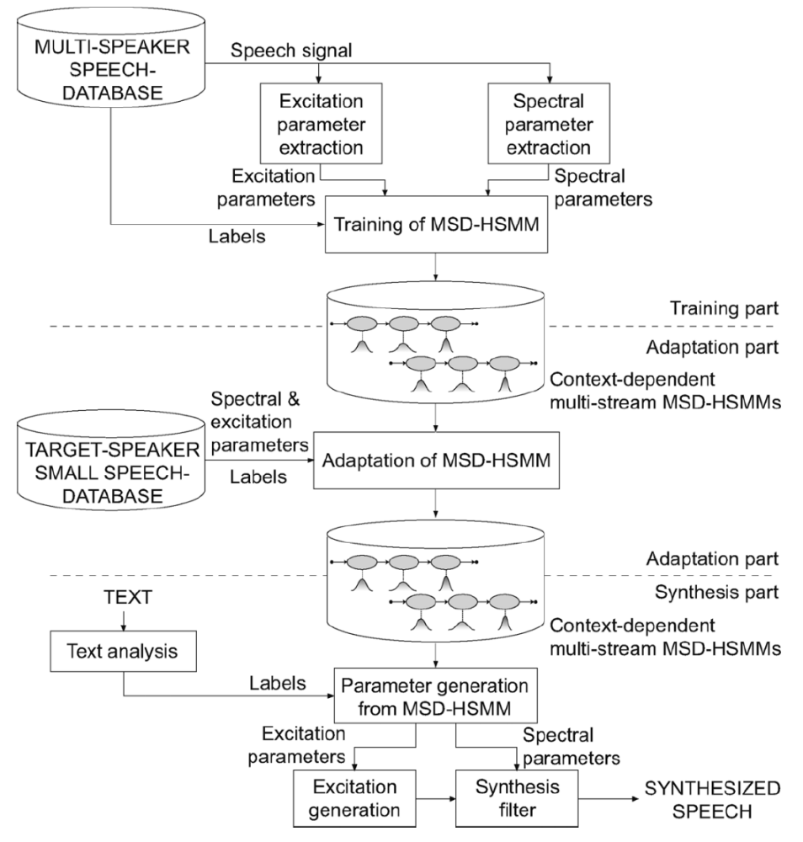

Slide 6





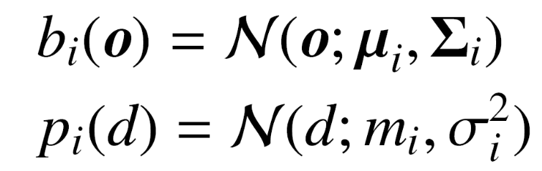


Hidden Semi-Markov Model
We assume that the -th state output and duration distributions are Gaussian distributions characterized by a mean vector and diagonal covariance matrix , and a scalar mean and variance .
where is an observation vector and is the duration in state .

Slide 7


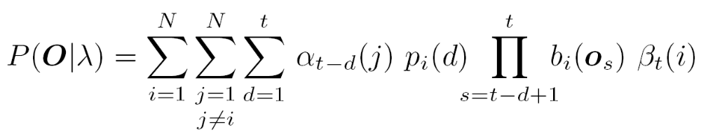

Hidden Semi-Markov Model
The observation probability of training data of length , given the model λ, can be written as
Where .

Slide 8




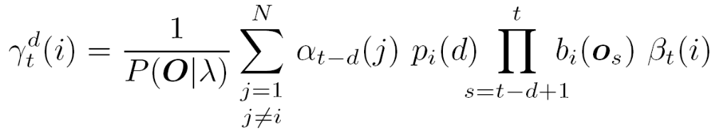
Hidden Semi-Markov Model
The state occupancy probability of being in the state at the period of time from to is defined as

Slide 9
Maximum Likelihood Linear Regression Based on Hidden Semi-Markov Model
In the HSMM-based MLLR adaptation, the mean vectors of the state output and duration distributions for the target speaker are obtained by linearly transforming the mean vectors of the state output and duration distributions of the average voice model (Fig. 3) as follows:

Slide 10
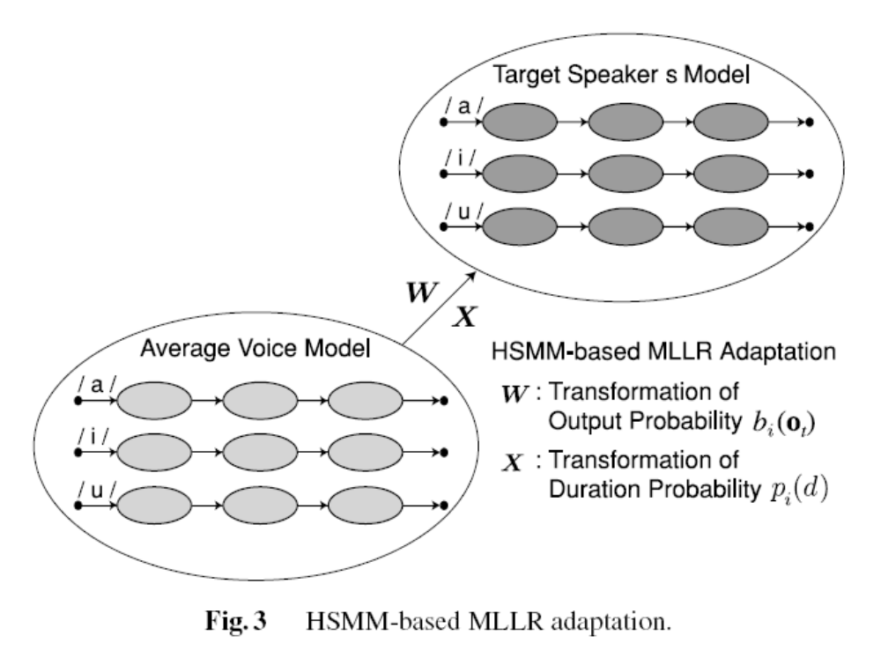

Slide 11
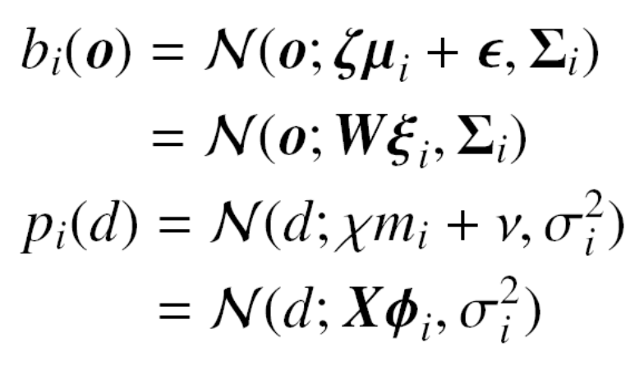




Maximum Likelihood Linear Regression Based on Hidden Semi-Markov Model
and are the transformation matrices which transform extended mean vectors and , respectively.

Slide 12



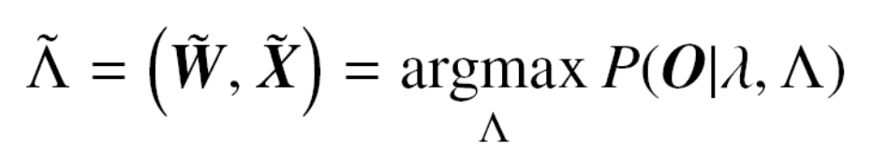
Maximum Likelihood Linear Regression Based on Hidden Semi-Markov Model
The HSMM-based MLLR adaptation estimates a set of transformation matrices so that the likelihood of the adaptation data of length is maximized.
The problem of the HSMM-based MLLR adaptation based on the ML criterion can be expressed as follows:
where λ is the parameter set of HSMM.

Slide 13
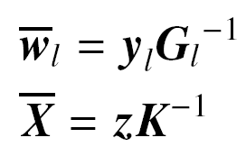







Maximum Likelihood Linear Regression Based on Hidden Semi-Markov Model
Re-estimation formulas:
where is the -th row vector of .
In these equations, , , , and
are given by

Slide 14
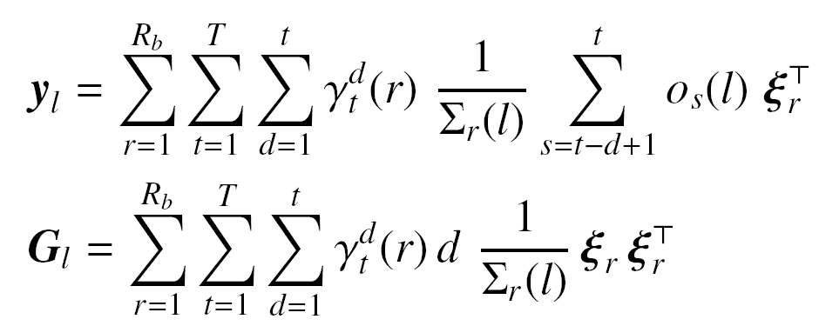
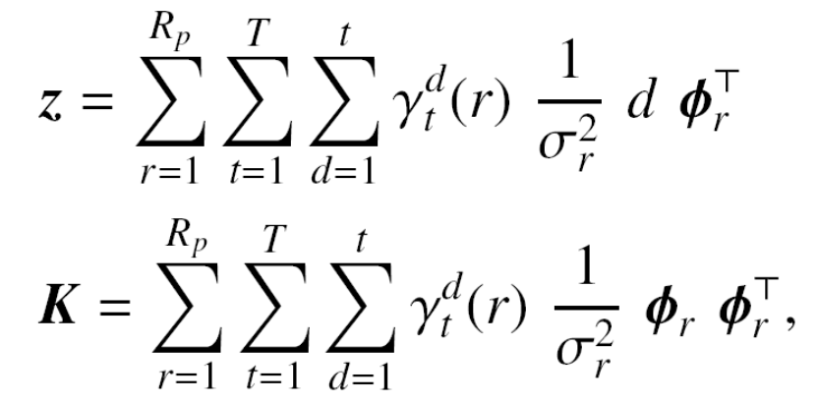
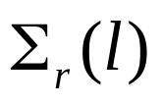


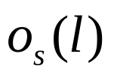

Maximum Likelihood Linear Regression Based on Hidden Semi-Markov Model
where is the -th diagonal element of the diagonal covariance matrix , and is the -th element of the observation vector .

Slide 15



Maximum Likelihood Linear Regression Based on Hidden Semi-Markov Model
It is not always possible to estimate and for every distribution, because the amount of adaptation data of a target style is limited.
Therefore, we use tree structures to group the distributions in the model and to tie the transformation matrices in each group in the same manner as HMM-based techniques.
and is respectively the number of the distributions of the state output and duration distributions belonging to this group.

Slide 16
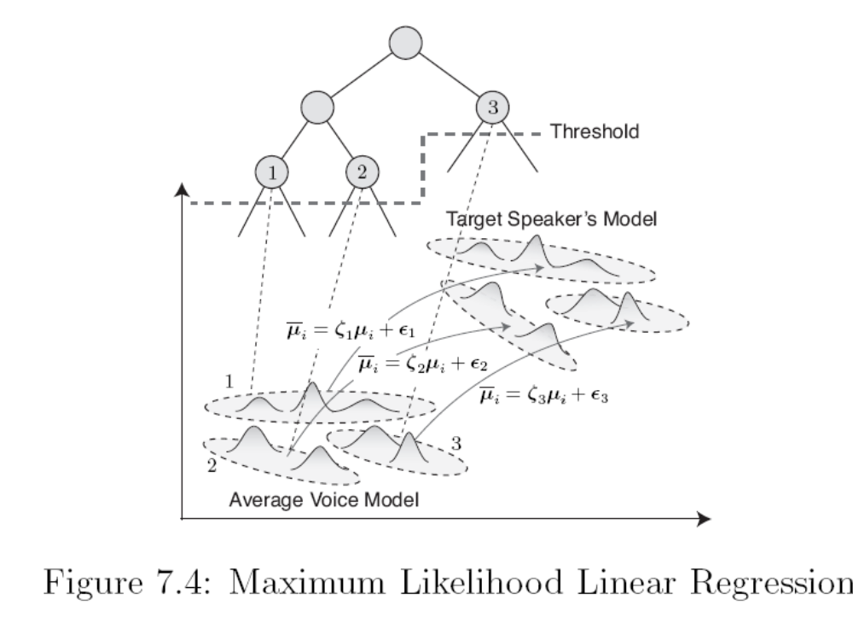

Slide 17
Experimental Conditions
We used the ATR Japanese speech database (Set B), which contains a set of 503 phonetically balanced sentences uttered by 6 male speakers and 4 female speakers.
We chose a male speaker MTK and a female speaker FTK as target speakers of the speaker adaptation and used the rest as training speakers for the average voice model.

Slide 18
Experimental Conditions
In the system, gender-dependent average voice models were trained using 453 sentences for each training speaker.
The total numbers of training sentences were 2265 sentences for male-speaker average voice model and 1812 sentences for female-speaker average voice model, respectively.

Slide 19
Objective Evaluation of the HSMM-Based MLLR Adaptation
We calculated the target speakers’ average mel-cepstral distance and root-mean-square (RMS) error of log F0 and vowel duration as the objective measure.
The adaptation data was from 5 sentences to 450 sentences.
Fifty test sentences were used for the evaluation, and these were included in neither the training nor the adaptation data.

Slide 20
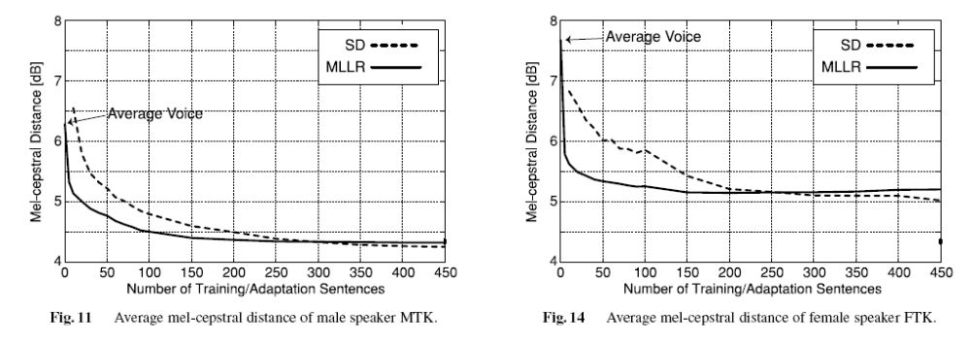

Slide 21
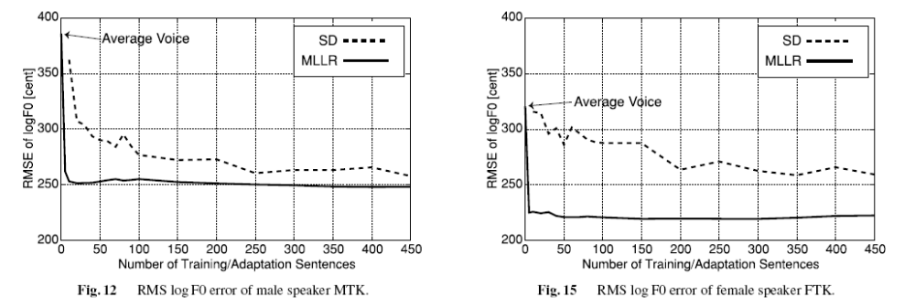

Slide 22
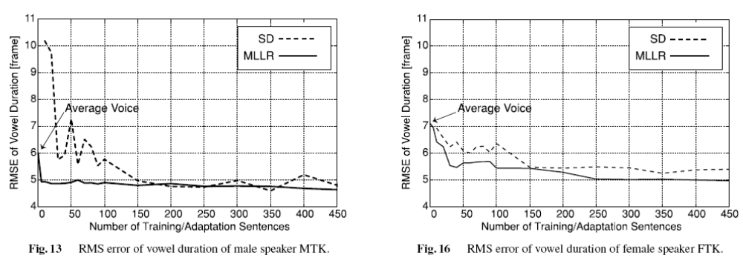

Slide 23
Subjective Evaluation of the HSMM-Based MLLR Adaptation
We compared the synthesized speech generated from the adapted models using 5, 10, 20, 50, 100, 150, 250, 350, and 450 sentences of the target speaker.
For each subject, five test sentences were randomly chosen from a set of 50 test sentences, which were contained in neither the training nor the adaptation data.

Slide 24
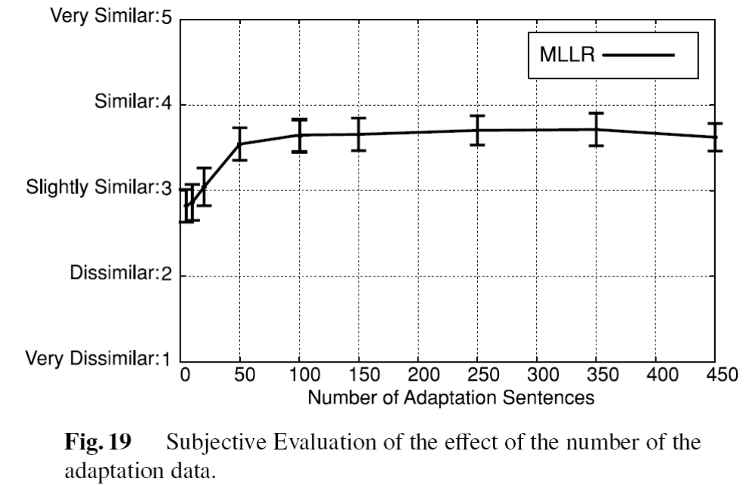

Slide 25
Subjective Evaluation of the HSMM-Based MLLR Adaptation
We compared the synthesized speech generated from eight models with or without the adaptation of spectrum, F0, and/or duration.
The adaptation data comprised 100 sentences.
For reference, we also compared synthesized speech generated from the SD model using 453 sentences of the target speaker.

Slide 26
